Slide 1
How to help the former refugee community through web presence

Slide 2
Brief
How it will help all those involved
Timeframe and costs
Permits

Slide 3
Centralized information space
The information space will work as follows:
Logical directory architecture
Information sharing via programming
Administration and User Privilege.

Slide 4
Former Refugee host help
For all members of the Dunedin Community
Directs to useful places for volunteering and tuition
Encourages intercultural discussion

Slide 5
Support groups and charity
Pinned area for organisations
Updated constantly
Only relevant information
Increased interorganisational communication

Slide 6
Former Refugee Help Tool
Make lives easier.
Learning tool.
Easier to ask for help.
Focused on Community Growth.

Slide 7
Main Objectives
We aim to achieve:
A centralized information space.
Organisation Involvement.
Heavy community based.

Slide 8
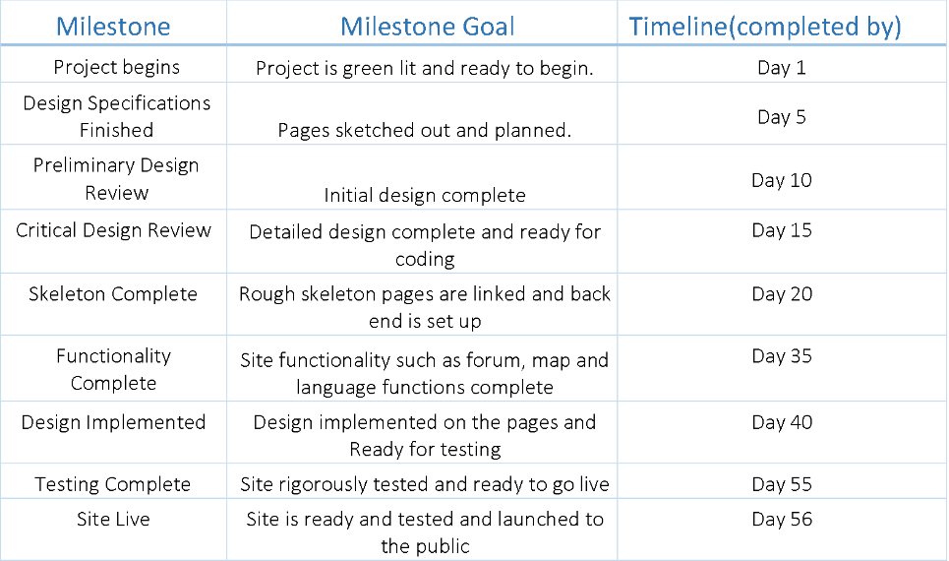
Milestones and Timeline

Slide 9
Fund Criteria
We believe we have meet the requirements in the following ways:
Beneficial to former Refugees.
Encourage community building
Exclusive involvement from organisations.

Slide 10
Start and End dates
Start Time ASAP
Start small and continue to grow
Great community solution

Slide 11
Budget Layout
5k and six weeks (Myth)
25000k and four weeks (Adon Moskal)
Cost is not set (Maintaining)
Software Engineering Project?
AWS Server for deployment(micro $0.0016)

Slide 12
Permits or Consent
No building consent .
"Courtesy Consent" from Organizations.
Terms and Conditions for users.

Slide 13
Questions

